Slide 1
Woodbridge Deanery Synod
Building a Generous Church
Julie Podd & Emma Denton, Parish Resources Team October 2023

Slide 2
Format
Building a culture of generosity
Information from the Anglican Giving Survey
Advantages of the Parish Giving Scheme
Digital Giving including online/QR code giving
Grants & Funding
Gifts in Wills
Discussion groups

Slide 3
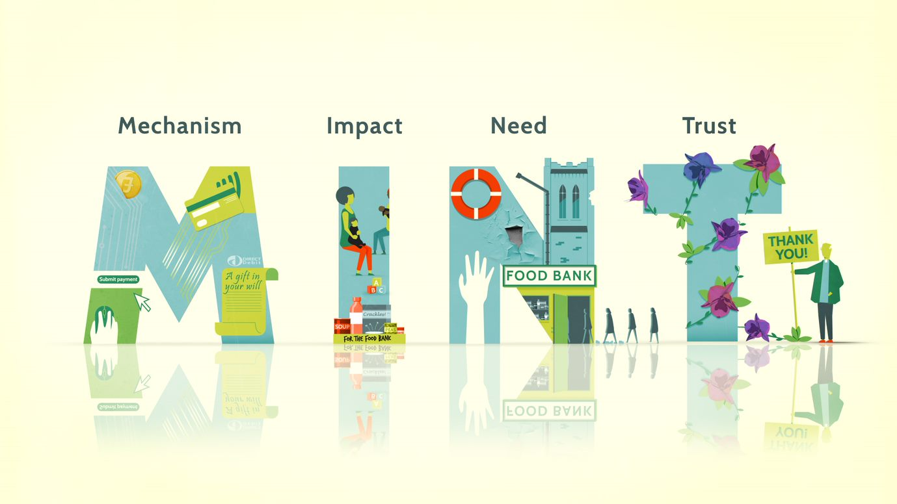
Building a culture of generosity
Get the mechanisms in place for easy giving
Share with givers what the impact of their giving will be
Show the need (how much does it cost per day to maintain church/ mission and outreach?)
Build trust by sharing stories of what the church is doing in your community
Notes:
Julie

Slide 4
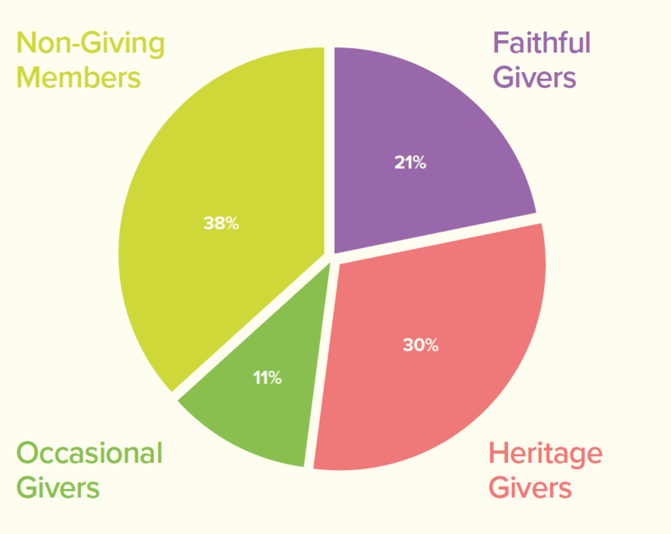
Anglican Giving Survey
21%
Look at the figures. Do any of these results surprise you?
38%
Sample of 2,000 people identifying as Anglicans in July-September 2020 who attend church regularly
11%
30%

Slide 5
Anglican Giving Survey - Headlines
38% of Anglicans do not give to their church
40% of Anglicans have not been asked to give
Nearly 50% of Anglicans have never been asked to review their giving
Less than 30% of people are regularly thanked for their giving
49% of Anglicans would give more if they understood the impact of their giving
Anglicans are three times as likely to leave a gift in their will to another charity rather than their church.
Sample of 2,000 people identifying as Anglicans in July-September 2020 who attend church regularly

Slide 6
Parish Giving Scheme - Why use it?
Best for regular giving (congregation & wider community)
Good for cashflow, includes automatic monthly Gift Aid return
Free for parishes to use (need to register) & parish gets all the donation
Easy for givers to amend their gift up or down
Optional inflationary increase helps avoid static giving
Givers can give online through the PGS website (or access with QR code), by telephone or using paper Gift Form
Ways that people start to give through the PGS: 60% online, 25% paper gift form, 15% use telephone service.
Givers are mostly using online 59%, then paper gift form 26% and telephone service 15% to start giving
Notes:
61% of people started giving through online portal in January 2023, 30% paper gift form and 9% on phone.
PGS poster with QR code in pack – try it out.

Slide 7
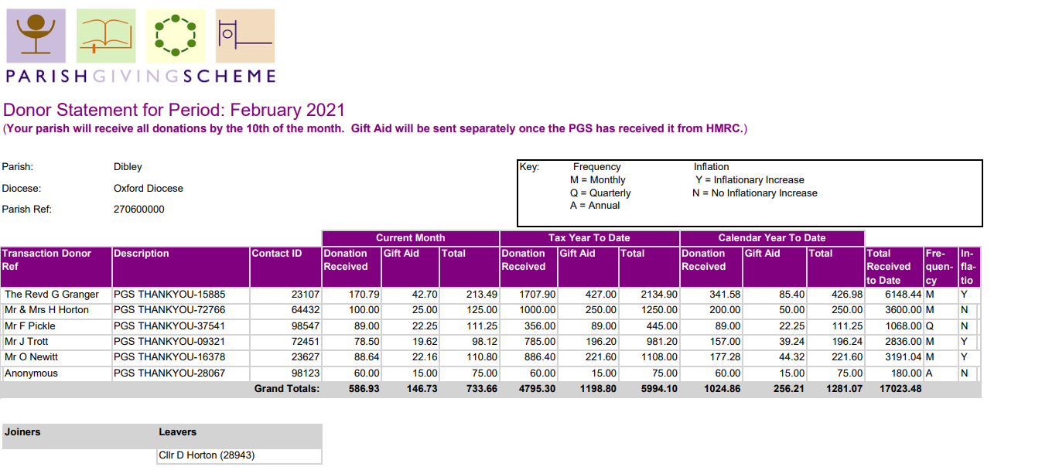
Statement receiver has access to monthly statements online
Only two entries per month on bank statement (gifts and Gift Aid)

Slide 8
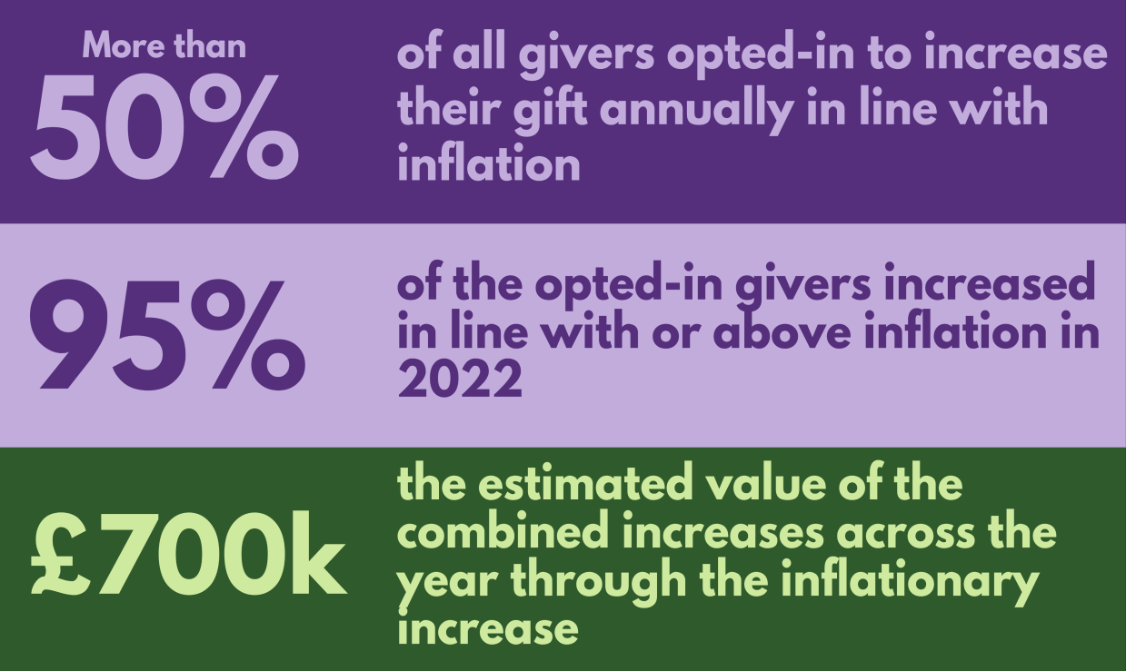
PGS Inflationary Giving – avoids static giving
National Figures
Our Diocese
54% of givers ‘opt in’ to inflationary increase
Even if givers tick the box on the form, they are asked a month before the increase is applied if they still want to do it
Givers can change their gift at any time (online, phone, email, letter)
Avoids static giving and having to make the ask!

Slide 9
PGS – One-off giving
Find it on your PGS page (see below) through online link or QR code
Just this year just under £44K (incl. GA) given through this method to our parishes
Note: For one-off gifts only, PGS charges 1.5% of gift’s value to cover card payment processor costs & bank charges (but passes full value of HMRC’s Gift Aid contribution back to the church)
https://www.parishgiving.org.uk/donors/find-your-parish/elmswell-st-john-the-divine-bury-st-edmunds/

Slide 10
Parish Giving Scheme (PGS)
“I’m not quite sure who to thank, but we are incredibly grateful to the Diocese for introducing the Parish Giving Scheme ... It’s definitely improved giving in our churches without a lot of effort … everyone finds having the Gift Aid as we go along much easier for cashflow and PCC members generally have reported that it's much easier to give than it used to be...” The Revd Tiffer Robinson, ex-Rural Dean (Lavenham), now at BSE St Mary
www.parishgiving.org.uk

Slide 11
2.5 How to join the PGS
PCC needs to formally decide to join at a PCC meeting
Complete registration form and return to pgs@cofesuffolk.org together with a paying in slip or other proof of bank details
Takes a few days for registration and then we email you resources
We have banners we can loan you and PGS tokens you can use in church
Can use QR code in newsletters, posters etc, to encourage wider community to give to your church
https://cofesuffolk.org/for-parishes/parish-stewardship-resources/parish-giving-scheme/

Slide 12
Launching the PGS
Do a Giving Review – Discuss at a PCC meeting
Launching (or re-launching) PGS as part of a giving programme has the greatest impact in signing up regular givers. Handy guide available
Promote link and QR code in parish newsletters, your ACNY page/website, posters, PCC lead from the front.
Practical act of discipleship inspired which can quickly have a positive impact for your church finances
www.cofesuffolk.org/for-parishes/parish-stewardship-resources/generosity-week/

Slide 13
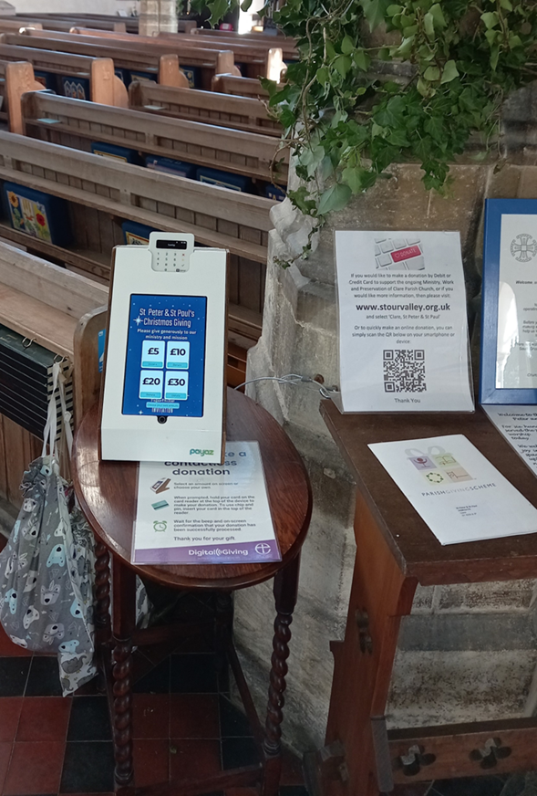
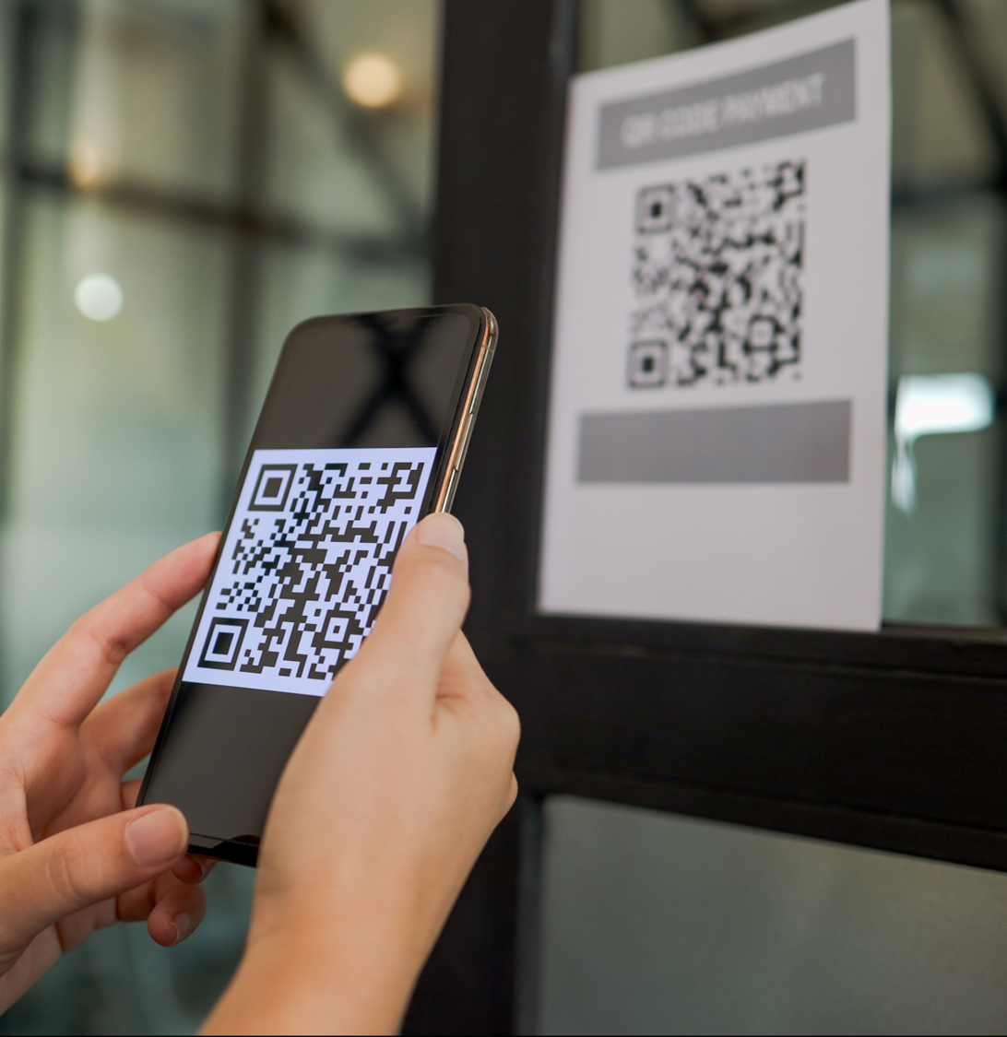
Digital Giving
Online giving: via QR code or web link
Donation devices: in-person giving by card or smart phone

Slide 14
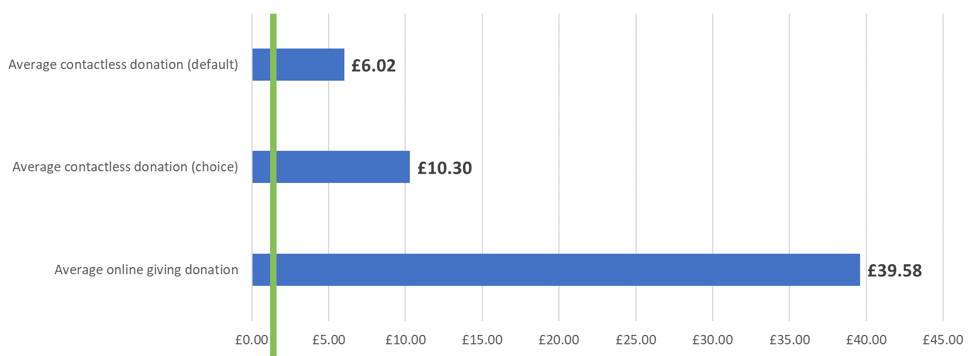
Contactless and online (+PGS) benefits over cash
Average cash donation: £2
Average weekly PGS giving in St Eds & Ips (ex GA): £15.30

Slide 15
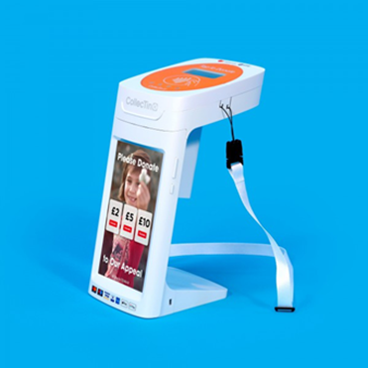
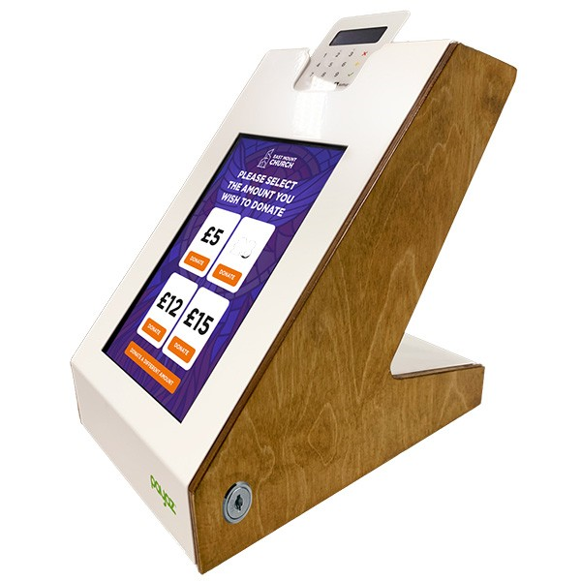
Using a SIM or wi-fi donation devices
No monthly charges for these devices.
If you have a SIM it will cost £50.40/year if bought through Daisy and Parish Buying.
Can connect to wi-fi in your church if you have it.
Both use Give A Little and Sum Up.
Transaction fees are 1.1% for debit cards and 1.3% for credit cards.
CollecTin More
For use with wifi or SIM (£3.50+VAT pm)
£295 through Parish Buying
Portable but can be secured
Payaz Giving Station
For use with wifi or SIM (£3.50 +VAT pm)
£393 through Parish Buying Not portable
Notes:
Yalda
- Consider if you would be better off getting wifi in your church esp if you have no mobile signal. Possibly not much more expensive than paying the monthly fee for offline devices and can be used for other purposes such as streaming services.
- There are other devices but these are the ones we use most.
- You can look at the end of the session and we will put the devices back on the parish resources desk if you want to see them afterwards.

Slide 16
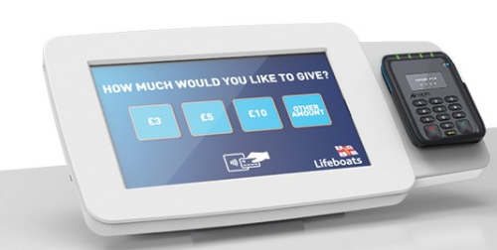
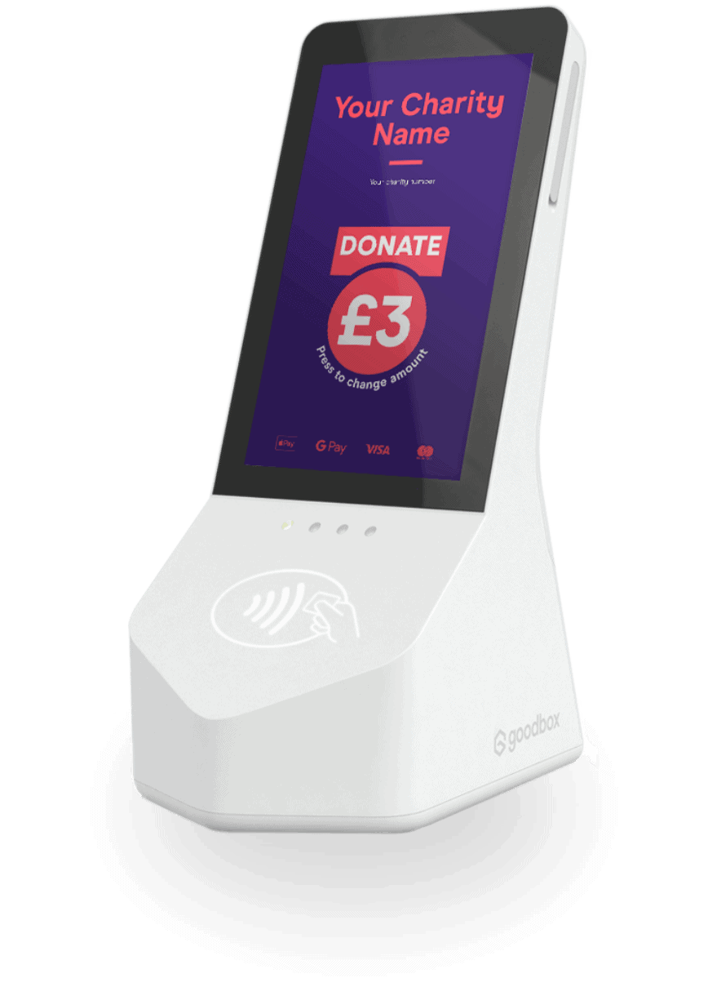
Offline Donation devices (no SIM signal or wi-fi)
GWD Midi
For use offline, portable
£675 +£13.50/month
Available through Parish Buying (we may have a free device). Transaction 5p/donation and 1.99% fee. Must be taken and connected to same wi-fi at least weekly to download donations
Goodbox Core
For use offline, portable
£325 +£15pm
Not available through Parish Buying but can buy direct from Goodbox. Transaction 10p/donation and 1.59% fee
Notes:
Yalda
- Consider if you would be better off getting wifi in your church esp if you have no mobile signal. Possibly not much more expensive than paying the monthly fee for offline devices and can be used for other purposes such as streaming services.
- There are other devices but these are the ones we use most.
- You can look at the end of the session and we will put the devices back on the parish resources desk if you want to see them afterwards.

Slide 17
What’s important for contactless giving?
An open church with sufficient footfall, visitors, events to make it worthwhile. Your congregation will hopefully be giving through the PGS!
The cost of the device and any ongoing costs (off-line devices or those using a SIM) must make it worthwhile financially and you must have enough signal (SIM) or wi-fi to run the device, or have an off-line device
You can claim back gift aid through GASDS as contactless donations are treated like cash
Many people don’t carry cash, so this makes giving easy and accessible and people usually give more

Slide 18
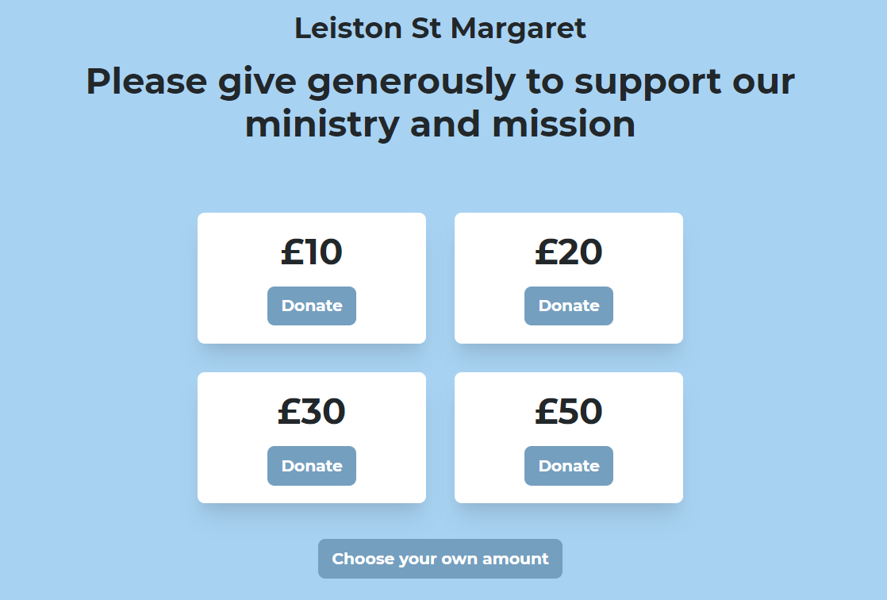
Online Giving with QR Codes
All parishes are encouraged to set up online giving (includes a QR code)
Get a free premium Give A Little account through Parish Buying using Sum Up or Stripe (payment providers)
Transaction rates: Sum Up – 1.95% Stripe – 1.1%

Slide 19
Online Giving with QR codes
Can easily download the QR code and put it on posters, service sheets, in parish newsletters, etc. Use the link for online services
Can make different campaigns, eg Christmas and Easter
Contact with the team for help to set up or visit Parish Buying

Slide 20
Grants & Funding – our offer
Visits to support your parishes from Emma Denton, Giving Advisor
Working with your parishes to create a grant strategy
Reading through grant applications
Access to Church Grants, Funding4Suffolk, Diocese & National Church information
Grants & Funding Guide
Diocese website: www.cofesuffolk.org/for-parishes/funding-for-your-parish/

Slide 21
New - Church Grants
Free search tool for all our churches showing filtered and checked information relevant to churches (e.g. bells, youth, community project)
Lists grant types and amounts each grant maker offers and their application process
Regularly checked to see that they are current and accurate
Opportunity to buy into further help and advice from Church Grants
Access to forum and training webinars
Ask Emma for parish code to access.

Slide 22
Gifts in Wills
Legacy giving is a statement of values and a celebration of life
Anglicans are three times as likely to leave a gift in their will to another charity rather than their church
Churches often lose out because they don’t ask, and don’t tell people how to leave a gift to their church

Slide 23
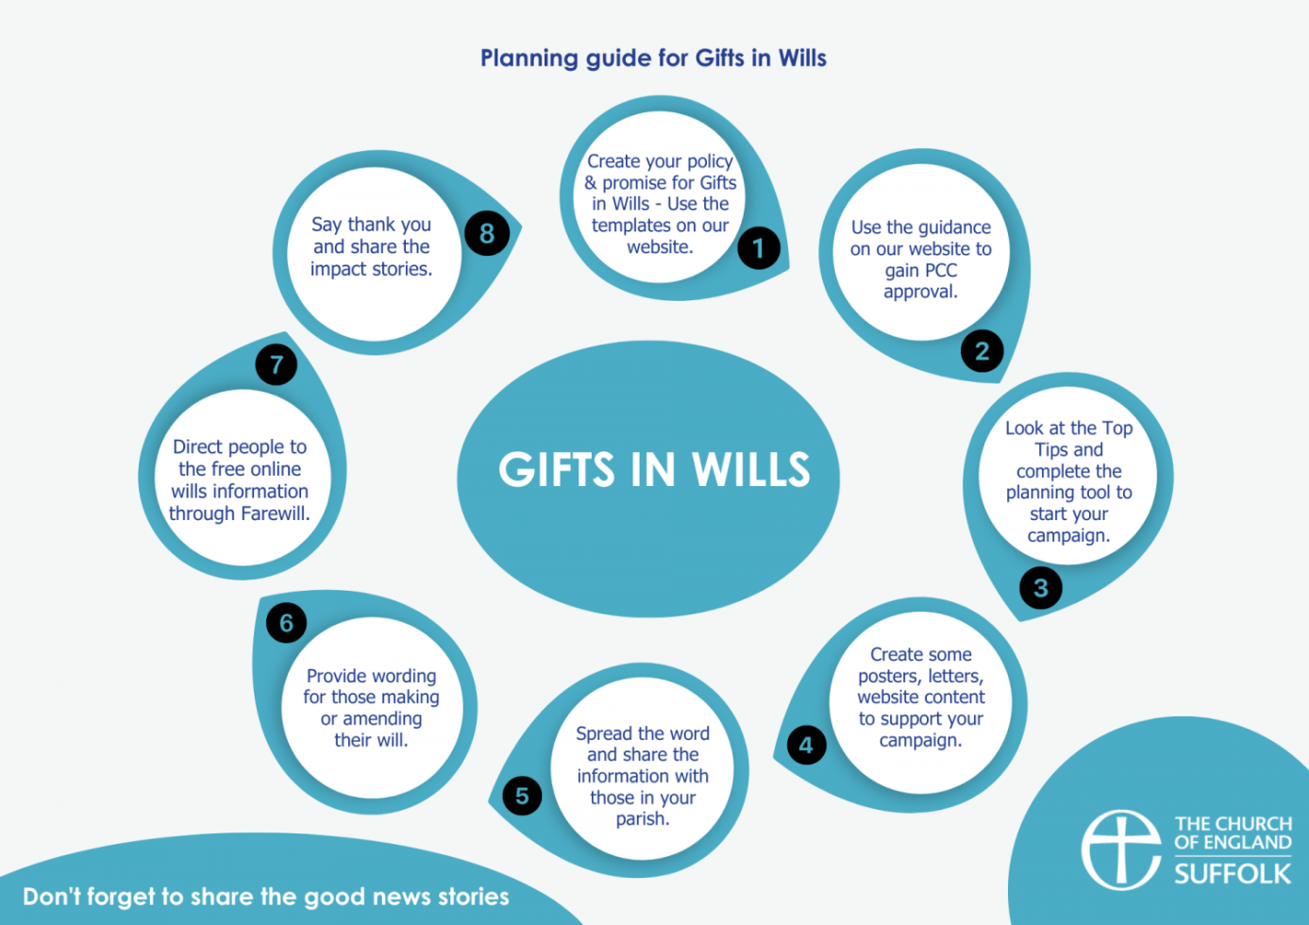
Call to action on encouraging Gifts in Wills
Encourage your parishes to:
Set up a Gifts in Wills policy
Have a named contact
Have resources to advertise how to leave a gift to your church
Provide sample wording for writing wills
Offer of free online wills through Farewill for all our parishes
Use all the resources on our website
www.cofesuffolk.org/for-parishes/parish-stewardship-resources/gifts-in-wills/

Slide 24
Saying ‘Thank you’ is important
We would encourage you to thank your generous givers at least once a year. The Anglican Giving Survey found that people would give more generously if they were thanked for their generosity, and it’s a nice thing to do!
I would like to thank you for all that you do for your churches and for taking the time to listen to us this evening
www.cofesuffolk.org/for-parishes/parish-stewardship-resources/ www.cofesuffolk.org/for-parishes/funding-for-your-parish/

Slide 25
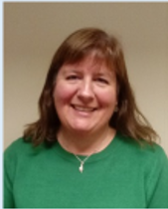
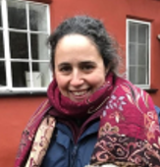
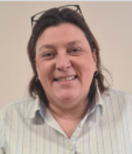
Julie Podd, Parish Resources Manager
julie.podd@cofesuffolk.org
Tel: 07826 556186 or 01473298555
Yalda Davis, Giving Advisor
yalda.davis@cofesuffolk.org
Tel: 07721 219534 or 01473 298557
Parish Giving Scheme, Gift Aid, Digital Giving, PCC Workshops
Emma Denton, Giving Advisor emma.denton@cofesuffolk.org
Tel: 07483 006379 or 01473 298556
Grants & Funding, Digital Giving, Gifts in Wills, Friends Groups, Parish Buying

Slide 26
The End

Slide 27
Building a generous culture in your church
https://youtu.be/2641TNa-MZw?feature=shared

